Slide 1
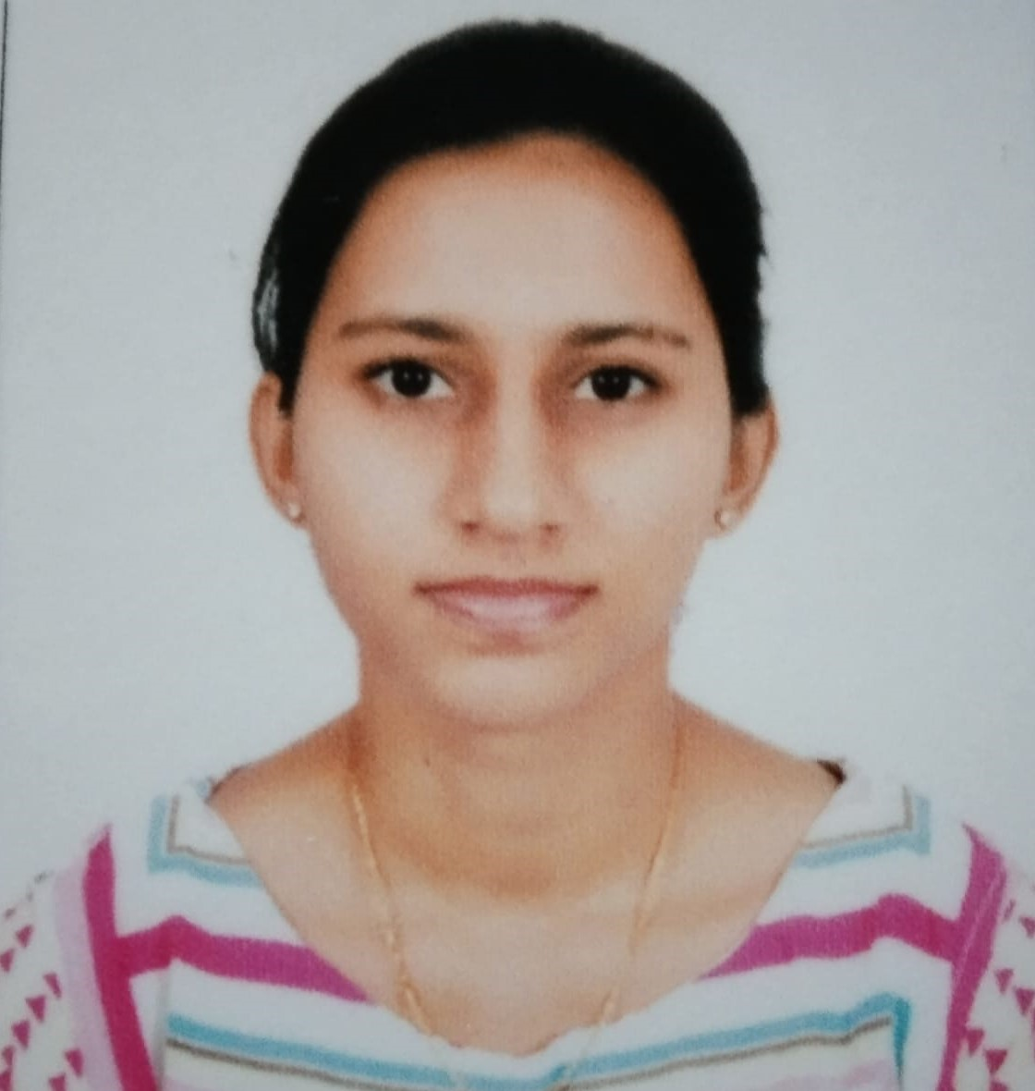

Ashlesha Deekonda
Analyst/Software Engineer
Bachelor of Technology
Electronics and Communication :
2017 – 2021
Skills JAVA 8
Spring Boot
Spring MVC
Bootstrap
Angular
Database:
SQL database-MySQL
Postgres SQL
Web Technologies
HTML5
CSS3
TypeScript
JavaScript
Additional Details:
Leadership
Peer Learning
Team management
AddOns:
GitHub
Postman
Bangalore
ashlesha.deekonda@capgemini.com
+91 8186089137
A4
Hands on experience in creating Web Application with Spring Boot , Rest Controller , JPA with Hibernate and Angular.
Practical Understanding of Query Language Like Postgres SQL, My SQL.
Proficient Full Stack developer with working knowledge on Angular.
Eager to work in a team of dedicated people and serve a key role in the enhancement and development of the project.
Implemented Web API and Angular in case study and up skilling this knowledge continuously.
Online Food Delivery Application:
Completed end to end case study of Online Food Delivery application along with Validations, Swagger and Angular used for user interface with Postgres as Database.
SENTIMENT ANALYSIS OF CART IN ONLINE FOOD DELIVERY SYSTEM:
Where Customers can visit online food app through online
And they can view the food items and by clicking on the image of the food item
That will take them to the cart and get the details on the cart along with the price.

